Slide 1
What the EF?
Common ORM Problems and How to Fix Them

Slide 2
Thank you!
New Stars of Data
Folks that encouraged me to blog and speak

Slide 3
Boring Slides

Slide 4
Intro
Who am I?
Josh! .NET Developer, SQL Server Enthusiast
I blog at https://joshthecoder.com
I'm active at Database Administrators Stack Exchange
...and at Top Answers
What are we talking about?
ORMs write the queries so us developers don't have to
Garbage In = Garbage Out
Some simple rules to avoid the biggest query pitfalls
Some more complex things developers should think about

Slide 5

Setup
Stack Overflow database
https://stackexchange.com/
BMOR is disabled (most folks not on 2019)
Forced Parameterization is enabled (very common for ORM DBs)
Using EF Core
All of these items apply to EF 6, though the code is slightly different
They also apply to other ORMs, like NHibernate
Extended Events to view queries being executed
Can also see with EF logging

Slide 6
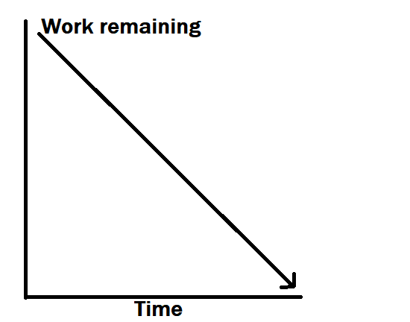

Sprint 1: The N+1 Query Problem
N+1 query problem
100 rows, 101 queries
Meet the developer, the PM, and the DBA

Slide 7
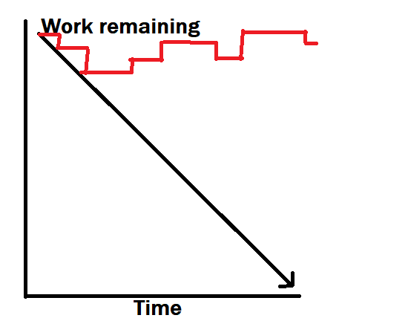
Sprint 1: The N+1 Query Problem
N+1 query problem
100 rows, 101 queries
Meet the developer, the PM, and the DBA

Slide 8
Sprint 1: The N+1 Query Problem
Lazy Loading is our friend
Except when it's not
Use JOINs (Include) if there are a lot of entities involved instead

Slide 9
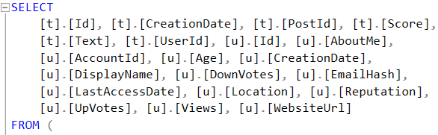
Sprint 2: SELECT * Is Evil
😱😱😱
Default behavior is to get all the columns
Really convenient for developers
Really hard for indexing
Wasteful on resources

Slide 10
Sprint 2: SELECT * Is Evil
😱😱😱
Always define a SELECT list (use the Select LINQ method)

Slide 11
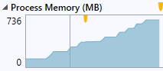

Sprint 3: Getting Too Much Data
It's not always obvious when the query is running (deferred execution), or why it's important
This can get us into trouble

Slide 12
Sprint 3: Getting Too Much Data
Developers aren't always aware of all the query features (e.g., OFFSET / FETCH)
We should do as much filtering as practical in the database
Avoid wasting SQL Server memory, network traffic, application memory, CPU

Slide 13
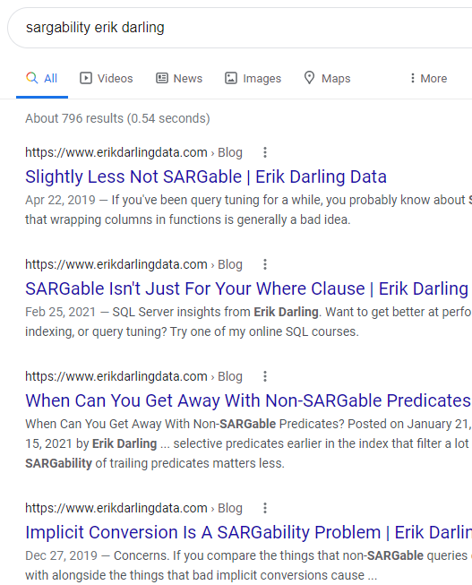
Sprint 4: SARGability
What?
Seriously...what?
Think about the phone book example for indexes

Slide 14


Sprint 4: SARGability
What?
Seriously...what?
Think about the phone book example for indexes

Slide 15
Sprint 4: SARGability
Try to avoid doing things that making SEEKing impossible
Running functions on search fields, doing "contains" searches on text
Fix the query, or get creative

Slide 16
Honorable Mentions
Kitchen sink queries
You can totally use query hints
Don't mix literals and variables (forced parameterization)

Slide 17

Questions to Ask
Do I need Includes?
Do I have a Select?
Am I filtering early?
Is this query SARGable?
Does this need an index?

Slide 18
ORMs aren't that bad
ORMs are bad
Databases were a mistake

Slide 19

Thanks!
Questions?

Slide 20
Thanks!
Misc acknowledgements:
Animation tutorial
https://dev.to/martyhimmel/animating-sprite-sheets-with-javascript-ag3
Art assets
https://thegameassetsmine.com/
http://finalbossblues.com/

